Slide 1
Bootcamp_Data Engineering Training
Prepared By,
Srimathi Chandrasekaran
26/05/2022

Slide 2
Chapter2: Python Spark in Depth
Intro to Spark in Bigdata -> 21/05/2022
Spark components & Architecture -> 21/05/2022
Pyspark shell , Pyspark job & Spark Web UI -> 24/05/2022
Spark RDDs & DataFrames -> 25/05/2022 & 26/05/2022
Spark SQL & Spark Mllib -> 26/05/2022
Spark GraphX

Slide 3
Dataframe:
Dataframes generally refers to a data structure, which is tabular in nature. It represents Rows, each of which consists of a number of observations. Rows can have a variety of data formats (Heterogeneous), whereas a column can have data of the same data type (Homogeneous). Data frames usually contain some metadata in addition to data; for example, column and row names.
We can say that Dataframes are nothing, but 2-Dimensional Data Structure, similar to an SQL table or a spreadsheet.

Slide 4
Why do we need Dataframes?
Dataframes are designed to process a large collection of structured as well as Semi-Structured data. It can also handle Petabytes of data.
Data frame APIs usually supports elaborate methods for slicing-and-dicing the data.So a critically important feature of data frames is the explicit management of missing data.
DataFrame has a support for a wide range of data format and sources.
It has API support for different languages like Python, R, Scala, Java, which makes it easier to be used by people having different programming backgrounds.

Slide 5

Features of Dataframes
Dataframes are Distributed in Nature, which makes it Fault Tolerant and Highly Available Data Structure.
Lazy evaluation is an evaluation strategy which holds the evaluation of an expression until its value is needed. It avoids repeated evaluation. Lazy evaluation in Spark means that the execution will not start until an action is triggered. In Spark, the picture of lazy evaluation comes when Spark transformations occur.
Dataframes are Immutable in nature. By immutable I mean that it is an object whose state cannot be modified after it is created. But we can transform its values by applying a certain transformation, like in RDDs.

Slide 6
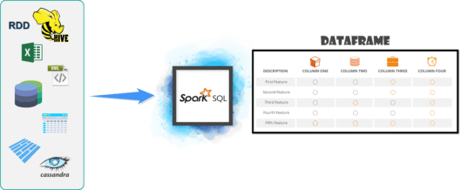
PySpark Dataframe Sources
Dataframes in Pyspark can be created in multiple ways:
Data can be loaded in through a CSV, JSON, XML or a Parquet file. It can also be created using an existing RDD and through any other database, like Hive or Cassandra as well. It can also take in data from HDFS or the local file system.

Slide 7
RDD | DataFrame | Dataset
Release version | Spark 1.0 | Spark 1.3 | Spark 1.6
Data Representation | Distributed collection of elements. | Distributed collection of data organized into columns. | Combination of RDD and DataFrame.
Data Formats | Structured and unstructured are accepted. | Structured and semi-structured are accepted. | Structured and unstructured are accepted.
Data Sources | Various data sources. | Various data sources. | Various data sources.
Immutability and Interoperability | Immutable partitions that easily transform into DataFrames. | Transforming into a DataFrame loses the original RDD. | The original RDD regenerates after transformation.
Compile-time type safety | Available compile-time type safety. | No compile-time type safety. Errors detect on runtime. | Available compile-time type safety.
Optimization | No built-in optimization engine. Each RDD is optimized individually. | Query optimization through the Catalyst optimizer. | Query optimization through the Catalyst optimizer, like DataFrames.
Serialization | RDD uses Java serialization to encode data and is expensive. Serialization requires sending both the data and structure between nodes. | There is no need for Java serialization and encoding. Serialization happens in memory in binary format. | Encoder handles conversions between JVM objects and tables, which is faster than Java serialization.
Garbage Collection | Creating and destroying individual objects creates garbage collection overhead. | Avoids garbage collection when creating or destroying objects. | No need for garbage collection
Efficiency | Efficiency decreased for serialization of individual objects. | In-memory serialization reduces overhead. Operations performed on serialized data without the need for deserialization. | Access to individual attributes without deserializing the whole object.
Lazy Evaluation | Yes. | Yes. | Yes.
Programming Language Support | Java Scala Python R | Java Scala Python R | Java Scala
Schema Projection | Schemas need to be defined manually. | Auto-discovery of file schemas. | Auto-discovery of file schemas.
Aggregation | Hard, slow to perform simple aggregations and grouping operations. | Fast for exploratory analysis. Aggregated statistics on large datasets are possible and perform quickly. | Fast aggregation on numerous datasets.

Slide 8
Dataframe Creation
Let’s move forward with this PySpark Dataframe Tutorial blog and understand how to create Dataframes.
We’ll create Employee and Department instances.
from pyspark.sql import *
Employee = Row("firstName", "lastName", "email", "salary")
employee1 = Employee('Basher', 'armbrust', 'bash@edureka.co', 100000)
employee2 = Employee('Daniel', 'meng', 'daniel@stanford.edu', 120000 )
employee3 = Employee('Muriel', None, 'muriel@waterloo.edu', 140000 )
employee4 = Employee('Rachel', 'wendell', 'rach_3@edureka.co', 160000 )
employee5 = Employee('Zach', 'galifianakis', 'zach_g@edureka.co', 160000 )
print(Employee[0])
print(employee3)
department1 = Row(id='123456', name='HR')
department2 = Row(id='789012', name='OPS')
department3 = Row(id='345678', name='FN')
department4 = Row(id='901234', name='DEV')

Slide 9
Next, we’ll create a DepartmentWithEmployees instance from the Employee and Departments
departmentWithEmployees1 = Row(department=department1, employees=[employee1, employee2, employee5])
departmentWithEmployees2 = Row(department=department2, employees=[employee3, employee4])
departmentWithEmployees3 = Row(department=department3, employees=[employee1, employee4, employee3])
departmentWithEmployees4 = Row(department=department4, employees=[employee2, employee3])
Let’s create our Dataframe from the list of Rows
departmentsWithEmployees_Seq = [departmentWithEmployees1, departmentWithEmployees2]
dframe = spark.createDataFrame(departmentsWithEmployees_Seq)
display(dframe)
dframe.show()

Slide 10
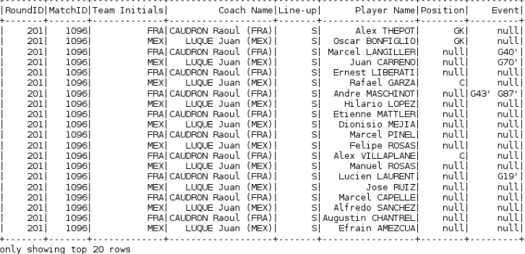
Pyspark Dataframes Example 1: FIFA World Cup Dataset
Here we have taken FIFA World Cup Players Dataset. We are going to load this data which is in CSV format into a dataframe and then we’ll learn about the different transformations and actions that can be performed on this dataframe.
Reading Data from CSV file
Let’s load the data from a CSV file. Here we are going to use the spark.read.csv method to load the data into a dataframe fifa_df. The actual method is spark.read.format[csv/json].
fifa_df = spark.read.csv("path-of-file/fifa_players.csv", inferSchema = True, header = True)
fifa_df.show()

Slide 11
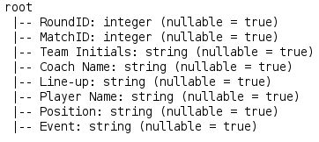
Schema of Dataframe
To have a look at the schema ie. the structure of the dataframe, we’ll use the printSchema method. This will give us the different columns in our dataframe along with the data type and the nullable conditions for that particular column.
fifa_df.printSchema()

Slide 12
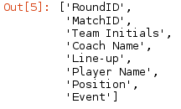
Column Names and Count (Rows and Column)
When we want to have a look at the names and a count of the number of Rows and Columns of a particular Dataframe, we use the following methods.
fifa_df.columns //Column Names
fifa_df.count() // Row Count => 37784
len(fifa_df.columns) //Column Count => 8

Slide 13
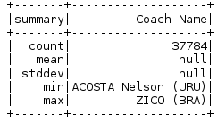
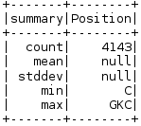
Describing a Particular Column
If we want to have a look at the summary of any particular column of a Dataframe, we use the describe method. This method gives us the statistical summary of the given column, if not specified, it provides the statistical summary of the dataframe.
fifa_df.describe('Coach Name').show()
fifa_df.describe('Position').show()

Slide 14
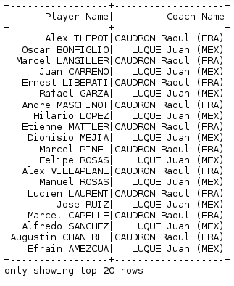
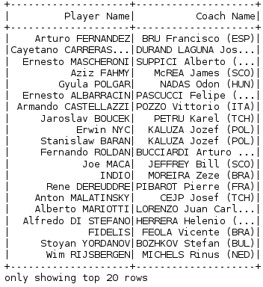
Selecting Multiple Columns
If we want to select particular columns from the dataframe, we use the select method.
fifa_df.select('Player Name','Coach Name').show()
Selecting Distinct Multiple Columns
fifa_df.select('Player Name','Coach Name').distinct().show()

Slide 15
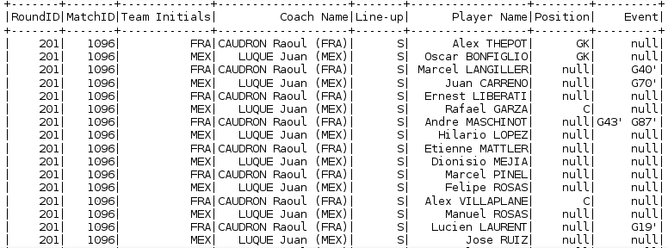
Filtering Data
In order to filter the data, according to the condition specified, we use the filter command. Here we are filtering our dataframe based on the condition that Match ID must be equal to 1096 and then we are calculating how many records/rows are there in the filtered output.
fifa_df.filter(fifa_df.MatchID=='1096').show()
fifa_df.filter(fifa_df.MatchID=='1096').count() //to get the count

Slide 16

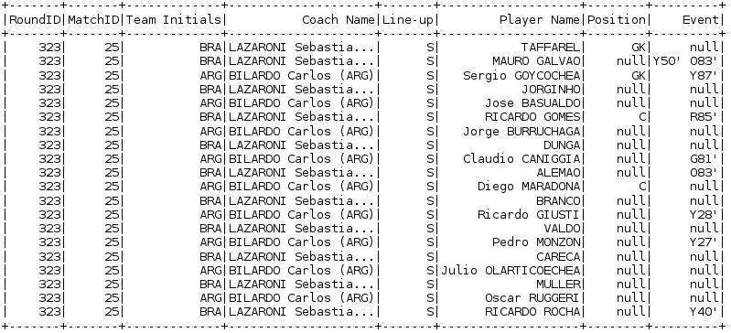
Filtering Data (Multiple Parameters)
We can filter our data based on multiple conditions (AND or OR)
fifa_df.filter((fifa_df.Position=='C') && (fifa_df.Event=="G40'")).show()
Sorting Data (OrderBy)
To sort the data we use the OrderBy method. By Default, it sorts in ascending order, but we can change it to descending order as well.
fifa_df.orderBy(fifa_df.MatchID).show()

Slide 17
Spark SQL
Spark SQL supports distributed in-memory computations on the huge scale. It is a spark module for structured data processing.
The major aspect of Spark SQL is that we can execute SQL queries. It can also be used to read data from an existing hive installation. When SQL runs in another programming language, then results come as dataset/dataframe.
By using the command-line or over JDBC/ODBC, we can interact with the SQL interface.

Slide 18
Spark SQL offers three main capabilities for using structured and semi-structured data. They are following below:
Spark SQL provides a dataframe abstraction in Python, Java, and Scala. It simplifies working with structured datasets. In Spark, SQL dataframes are same as tables in a relational database.
Spark SQL can read and write data in various structured formats, such as JSON, hive tables, and parquet.
By using SQL, we can query the data, both inside a Spark program and from external tools that connect to Spark SQL.
Same as Spark in Spark SQL, developers can switch back and forth between different APIs. Thus, it is the most natural way to express a given transformation.

Slide 19
Why Spark SQL Came Into Picture?
As Apache Hive, Spark SQL also originated to run on top of Spark and is now integrated with the Spark stack. There were certain limitations of Apache Hive as list-up below. Spark SQL was come into the picture to overcome these drawbacks and replace Apache Hive.
Limitations With Hive:
As for executing the ad-hoc queries, Hive launches MapReduce jobs internally. When it comes to the analysis of medium-sized datasets (10 to 200 GB) MapReduce lags in the performance.
There is no resume capability in Hive. So, if the processing dies in the middle of a workflow, we cannot resume from where it got stuck.
When trash is enabled Hive, we cannot drop encrypted databases in cascade, that leads to an execution error. Afterwards, users have to use purge option to skip trash instead of drop.
Due to these drawbacks, Spark SQL performace is better and it comes in picture.

Slide 20
Spark SQL Datasets
It is an interface, provides the advantages of RDDs with the comfort of Spark SQL’s execution engine. It is a distributed collection of data to construct a dataset, we can use JVM objects. Afterwards, it can manipulate using functional transformations such as map, flatMap, filter, etc. and many more.
In two languages, dataset API is available like Scala and Java. R and Python do not support dataset API. But, as Python is very dynamic in nature. It provides many of the benefits of the dataset API, such as we can access the field of a row by name naturally row.columnName.

Slide 21
Spark SQL DataFrames
As similar as RDD, dataframes are also immutable in nature. In dataframes, data is organized into named columns. Also, they are similar to a relational database. It is designed large data sets processing even easier.
There are following ways to create dataframes such as:
With structured data files
From tables in Hive
With external databases
By using existing RDD
Dataframes provides richer optimizations to us. API of dataframes is available in Scala, Java, Python, and R as well. Dataframe is represented by a dataset of rows in Scala and Java. It is simply a type alias of dataset[Row] in Scala API.
Whereas in Java API, users need to use dataset<Row> to represent a dataframe. SQL provides a domain specific language API to manipulate our distributed data. It also makes Spark accessible to a wider audience, beyond specialized data engineers.

Slide 22
Features of Spark SQL DataFrame
Few characteristics of dataframe in spark are:
It provides an ability to process the data in the size of kilobytes to petabytes. Even on a single node cluster to large cluster.
Dataframes supports different data formats, such as Avro, csv, elastic search, and cassandra. It also supports storage systems like HDFS, HIVE tables, MySQL, etc.
By using Spark-core, it can be easily integrated with all big data tools and frameworks.
Dataframes provides API for Python, Java, Scala, as well as R programming.
Spark Catalyst Optimizer
We can say, most of the power of Spark SQL comes due to catalyst optimizer. It primarily leverages functional programming constructs of Scala such as pattern matching. Catalyst optimizer offers a general framework for transforming trees.
Those we can use to perform analysis, optimization, planning, and runtime code generation.
Generally, there are two primary goals of catalyst optimizer:
It makes adding new optimization techniques easy.
This optimizer also enables external developers to extend the optimizer.

Slide 23
Basically, in four phases, it uses catalyst’s transformation framework such as :
By analyzing a logical plan to resolve references
With logical plan optimization
By physical planning
With code generation to compile the parts of the query to Java bytecode
In addition, it optimizes all the queries written in Spark SQL and dataframe DSL. It enhances the speed of the system. Optimizer helps us to run queries much faster than their counter RDD part. As much as fast speed, it will have more performance it will increase.
There is a library “Spark Catalyst” as a rule-based system. Each rule focusses on the specific optimization. Likewise, constantfolding focus on eliminating constant expression from the query.

Slide 24
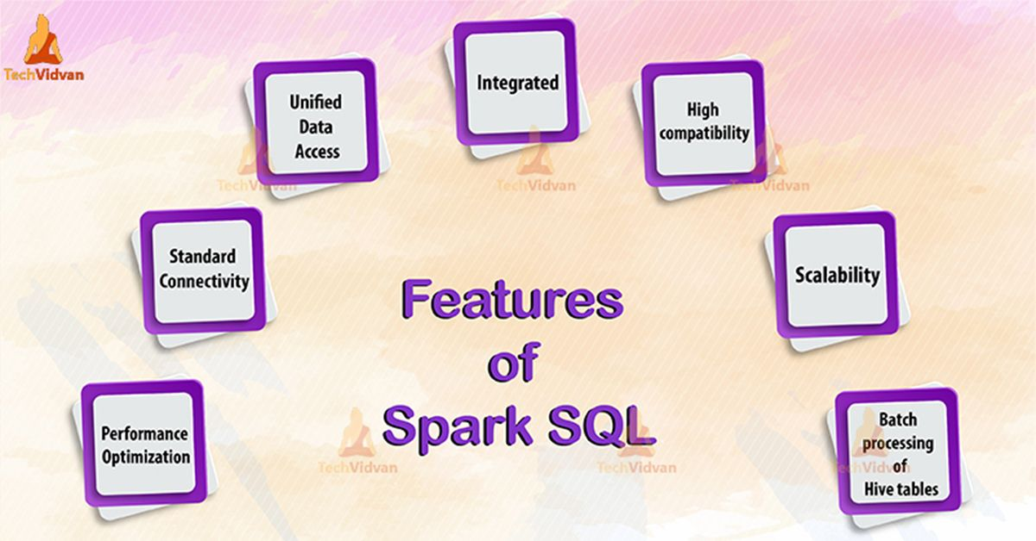
1. Spark SQL is Integrated
With integrated APIs in Python, Scala etc. we query structured data as RDD in Spark. Due to integration, we can easily run SQL queries alongside complex analytic algorithms.
2. Unified data access
For working with structured data, Schema-RDDs provide a single interface. Also, includes Apache Hive tables, parquet files, and JSON files.
3. Hive compatibility
It reuses the Hive front-end and meta store. In SparkSQL, we can have full compatibility with current Hive data, queries and UDFs.
4. Standard connectivity
Offers server mode with the connectivity of industry standard JDBC and ODBC.

Slide 25
5. Scalability
We can use the same engine for both interactive as well as long queries.
6. Performance optimization
In SparkSQL, each SQL query converts to a logical plan. This is possible by using the query optimization engine. Moreover, it converts to many physical execution plans. It selects the most optimal physical plan for execution of the entire plan.
7. For batch processing of Hive tables
For fast batch processing of Hive tables, we can use Spark SQL.
Uses of Spark SQL
Most importantly, it executes SQL queries.
We can read data from existing Hive installation by using SparkSQL.
While we run SQL, at another programming language, it results in a dataset/dataframe.

Slide 26
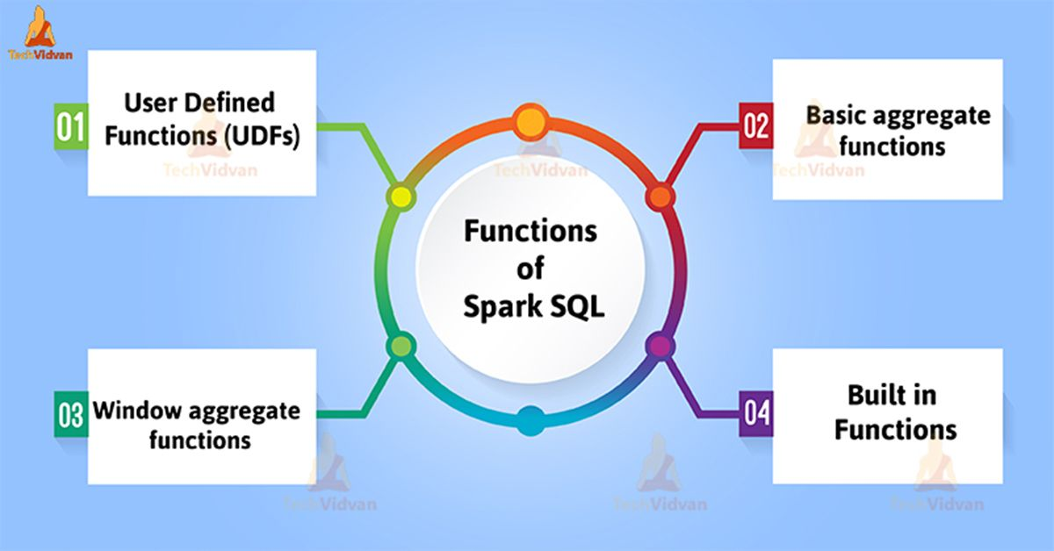
Functions defined by Spark SQL

Slide 27
User Defined Functions (UDFs)
It takes values from a single row as input. Afterwards, it generates a single return value for every input row.
2. Basic aggregate functions
It operates on a group of rows, then calculates a single return value per group.
3. Window aggregate functions
It operates on a group of rows. It also calculates a single return value for each row in a group.
4. Built-in function
Spark SQL offers a built-in function to process the column value.
By using the following command we can access built-in function:
Import org.apache.spark.sql.functions

Slide 28
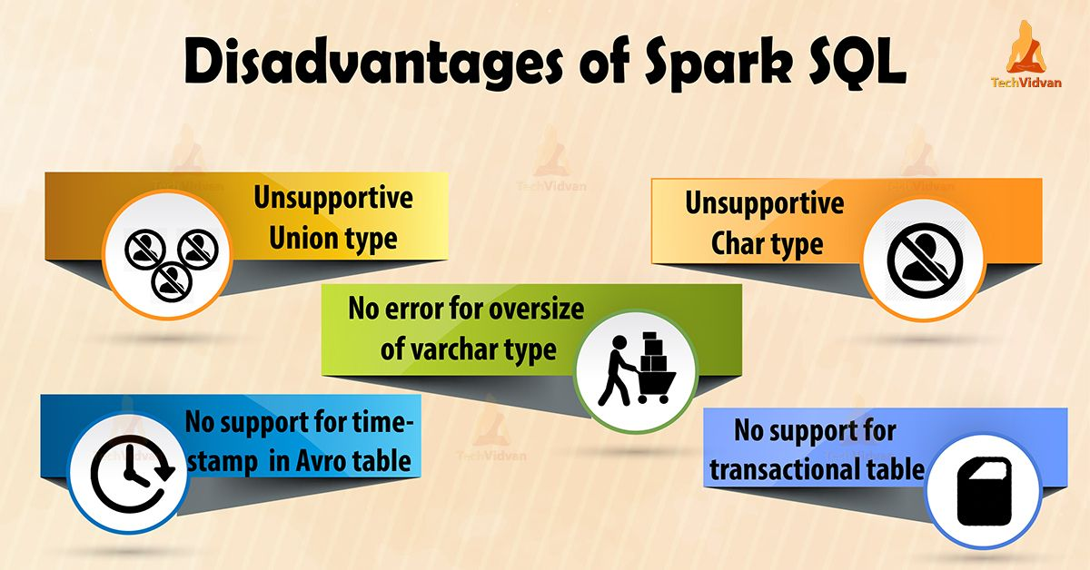
Disadvantages of Spark SQL

Slide 29



